Slide 1
Graph Analytics for Nanoscale Connectomics (GAC)
Cortical Layer-Based Subgraph Metrics

Slide 2
Overview of Graph
June Data Connectome Graph
64,996 nodes 28,098,488 edges

Slide 3
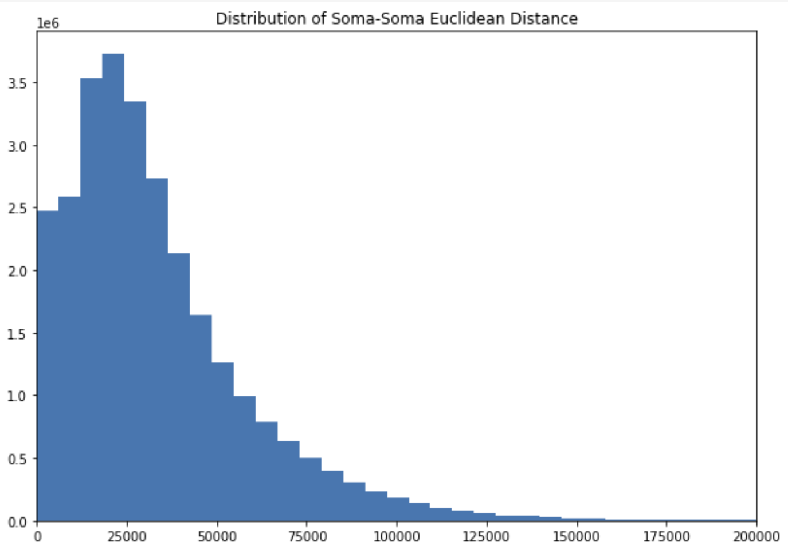
Graph Metrics on entire volume

Slide 4
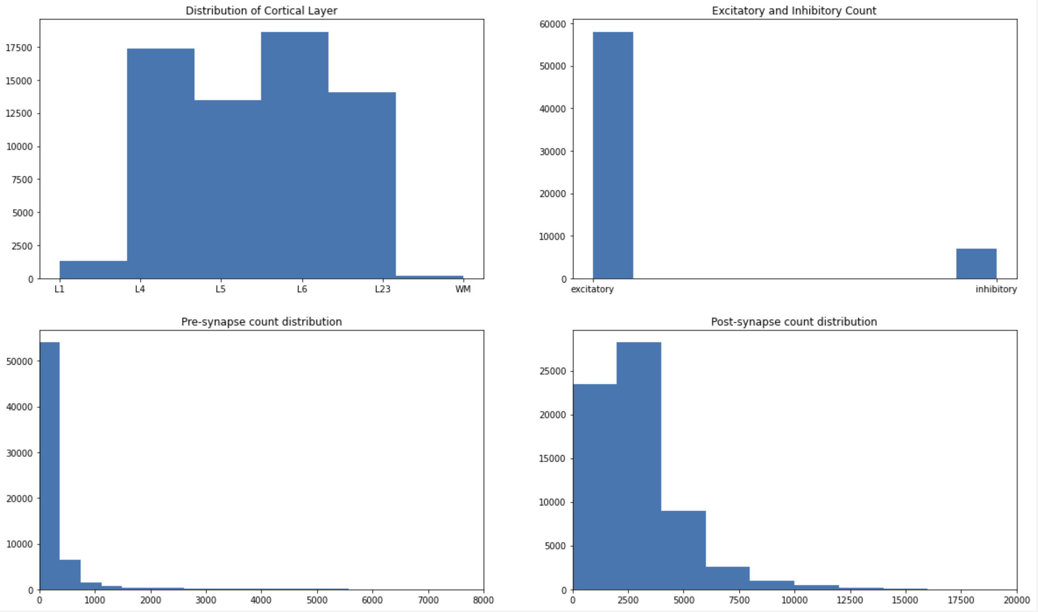
Graph Metrics on entire volume cont.

Slide 5
Overview of Subgraphs
Layer Subgraph | Nodes | Edges | Rough Estimates for Volume (mm^3)
L1 | 1,288 | 10,119 | 0.1541
L23 | 14,049 | 767,863 | 0.0868
L4 | 17,339 | 1,194,054 | 0.0968
L5 | 13,439 | 1,212,430 | 0.1175
L6 | 18,626 | 1,023,028 | 0.1427
WM | 180 | 454 | 0.2060

Slide 6
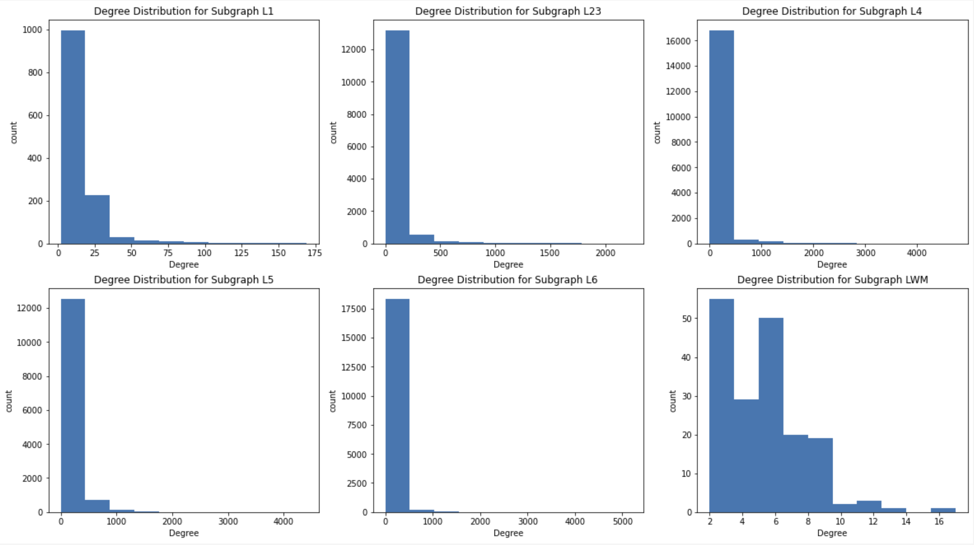
Degree Distribution for each Subgraph

Slide 7
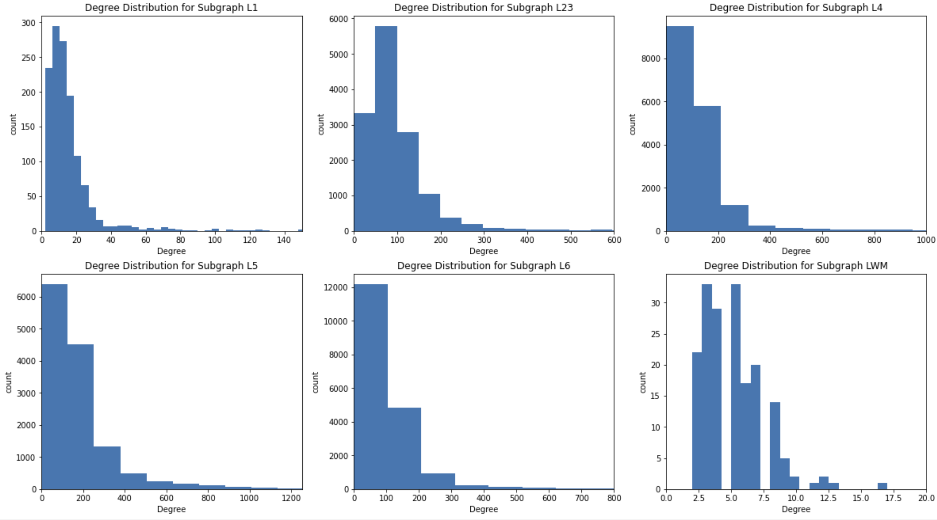
Degree Distribution for each Subgraph (w/o outliers)

Slide 8
Additional Statistics

Slide 9
Graph Metrics
Part I
Layer Subgraph | Nodes | Edges | Volume Estimates | Number of Strongly Connected Components
L1 | 1,288 | 10,119 | 0.1541 mm^3 | 29
L23 | 14,049 | 767,863 | 0.0868 mm^3 | 55
L4 | 17,339 | 1,194,054 | 0.0968 mm^3 | 53
L5 | 13,439 | 1,212,430 | 0.1175 mm^3 | 51
L6 | 18,626 | 1,023,028 | 0.1427 mm^3 | 76
WM | 180 | 454 | 0.2060 mm^3 | 26

Slide 10
Graph Metrics
Part II
Layer Subgraph | Transitivity Coefficient | Number of Cliques | Graph Density | Avg Closeness Centrality
L1 | 0.14571 | 5,990 | 0.00610 | 0.14803
L23 | 0.16227 | 6,560,270 | 0.00389 | 0.28652
L4 | 0.16198 | 29,400,697 | 0.00397 | 0.30404
L5 | 0.13892 | 57,795,721 | 0.00671 | 0.32420
L6 | 0.08354 | 4,078,822 | 0.00295 | 0.30554
WM | 0.09149 | 219 | 0.01409 | 0.03251

Slide 11
Further Work / Discussion
Computing and comparing various graph metrics across the different cortical layers can reveal interesting connectivity patterns
Interesting patterns observed in the June Data:
Layer 6 has the largest number of strongly connected components but the lowest transitivity coefficient
Layer 6 additionally has the smallest Graph Density
Further work
Additional graph metrics such as Omega and Sigma values can give further insight and characterization of these subgraphs as Small world, demonstrating high clustering and low average path length
Extract connectivity patterns or motifs from each subgraph to better summarize connectome topology
Studying these graph metrics can also provide expert proofreaders with a better understanding of proofreading status of the connectome

